Slide 1
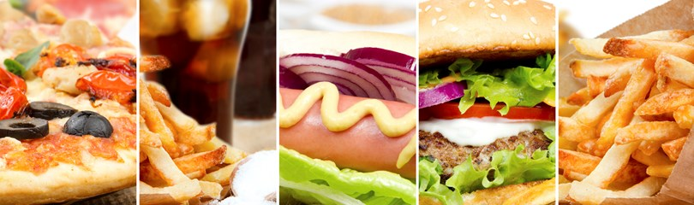
Restaurant Ordering App
Alsalt Alkharusi and Yaqoob Al Farsi

Slide 2
Proceedings
Project Scope
Objectives
Limitation of Classical System
Advantages of Proposed System
Phases of Project
Architecture Design
Activity Diagram
Application Interfaces
Notes:
Agenda of our today presentation is divided in to 8 main topics. We will start with Project Scope by defining the scope of our proposed system. Then we will state the objectives ,limitations of classical system and advantages of our proposed app then we will move to phases of project and explain the phases with the help of a gantt chart. After that architecure design of the app will be discussed following by the activity diagrams and the application interfaces.

Slide 3
Project Scope
Allocation of approximately all restaurants on the map
Updated Menu of restaurant by the admin.
Track order feature.
Pay through an online service (credit card and papal) or in person by cash.
Receiving invoice from the restaurant.
Notes:
In todays age of fast food and take-out, many restaurants have chosen to focus on quick preparation and speedy delivery of orders rather than offering a rich dining experience. Our project covers the online ordering domain of restaurants.
The main advantage of oursystem is that it greatly simplifies the ordering process for both the customer and the restaurant

Slide 4
Objectives
Easy approach to place order.
Quick service by restaurants.
Deliver fresh food to customers(s) at their doorstep.
Secure way to pay online and increasing customer satisfaction
Notes:
Main aim of our project is to simplify and improve the efficiency of the ordering process for both customer and restaurant. Our system will minimize manual data entry and ensure data accuracyand security during order placement process. Customers will also be able to view product menus and track his order and be able to have a visual confirmation that the order was place correctly.

Slide 5
Limitation of Classical Ordering System
Physical copy of the menu needed by customer.
Time consuming.
Lack of visual confirmation that the order was placed correctly.
Necessity for restaurant to have an employee answering the phone and taking orders.
Difficulty in tracking customers past history.
Manual work and consumes large volumes of data.
Lack of data security.
Notes:
In classical ordering system, customer required the physical copy of menu to place his order. Obviously you cant keep all the hard copy menu of your favorite restaurants with you all the time.
Order placing is time consuming process where restaurant need to have employees to answer the phone calls and take orders which sometmie lead to misunderstanding as due to noise on phone call on either side can make it happen, Eventually customer gets frustrated and his time wasted.
For restaurants it is difficult to keep track of all the phone calls coming from their regular customers.

Slide 6
Advantages
Convenient; Easy to use.
No misunderstandings and no frustrations.
Security of data. Data are well protected for personal use.
Ensures data accuracy during order placement process.
Minimized manual data entry.
Notes:
According to Cowen & Company Researach Report, Online ordering now represents 30% of the daily takeaway ordering and the number keeps growing. Why is this happening? Two main reasons:
It’s very convenient:
Studies show that about 69% of customers order food online using a mobile device. Whether stuck in traffic, riding the bus or on a break, anyone can place an order quickly and easily, as opposed to waiting until getting home or starting to call.
No misunderstandings and no frustrations:
One of the biggest issues with phone conversations is that misunderstandings can happen quite easily. Usually due to the noise, either in the restaurant or on the other end of the line, all it takes is one mistake to compromise an order and frustrate a customer. With online ordering, all preferences are specified directly by the customer, so there is no room for confusions or misunderstandings.

Slide 7
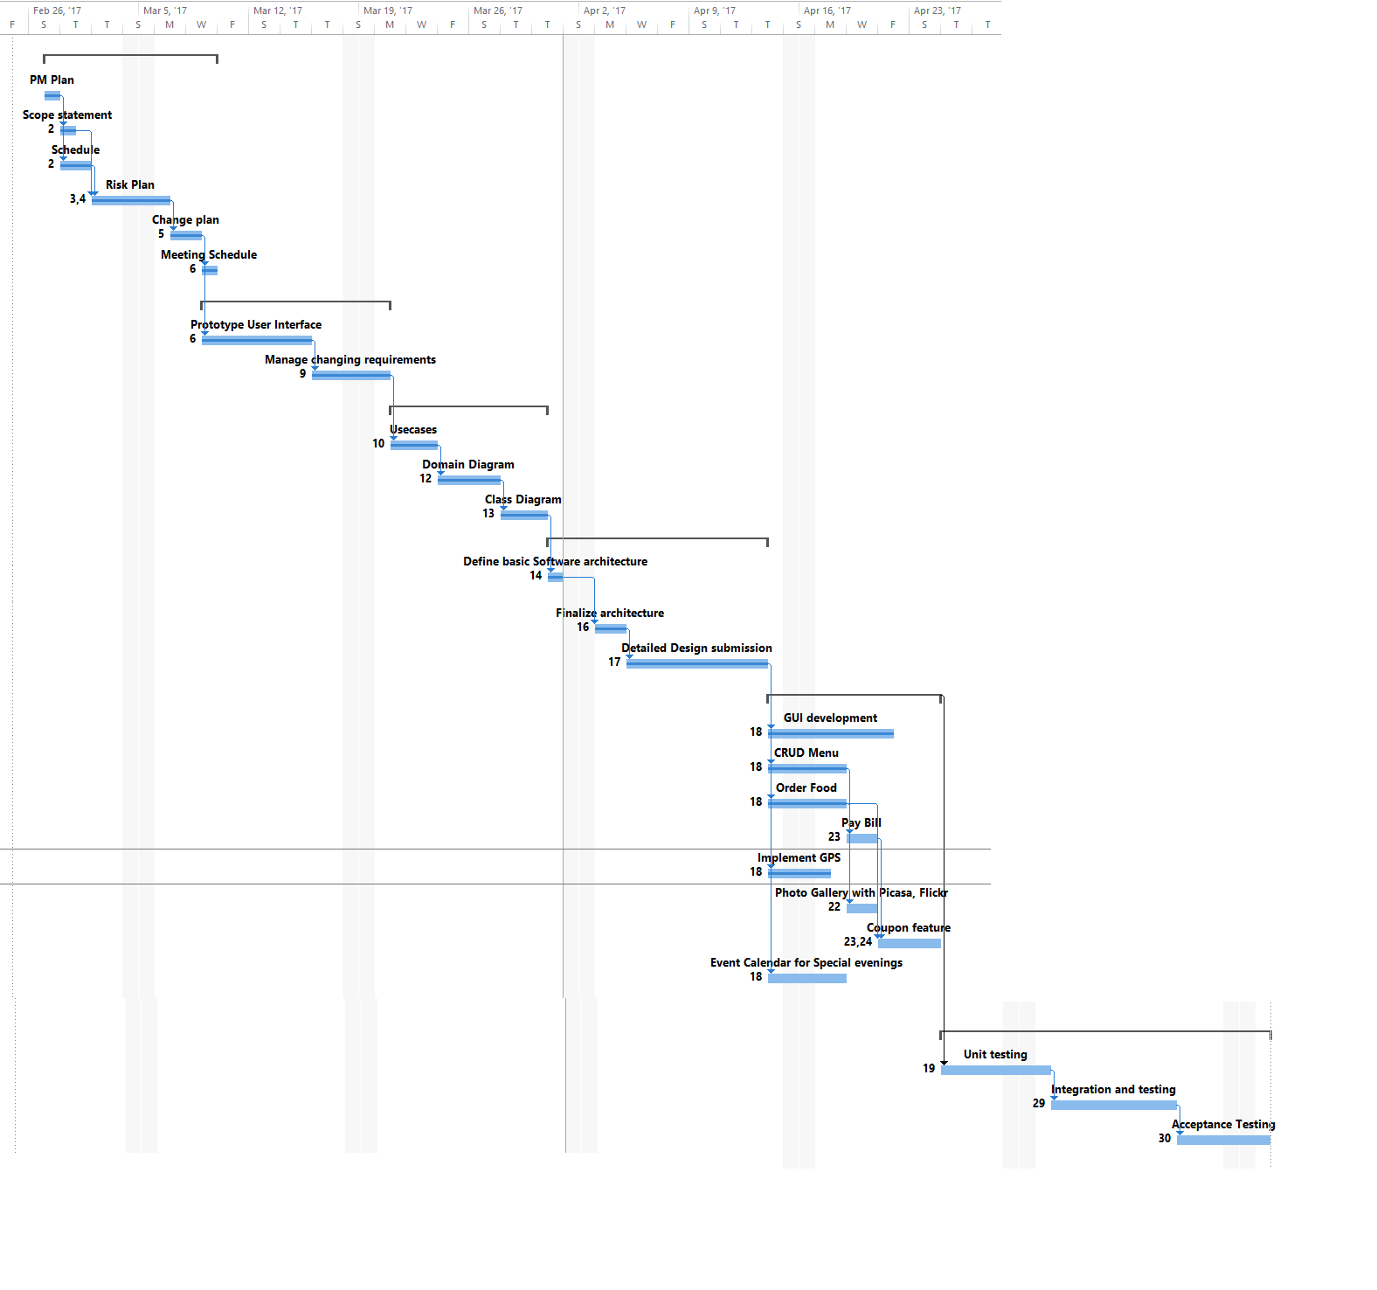
PHASES OF PROJECT
Notes:
In this gantt chart all the phases of the project is illustrated.Our first phse of the project is PM Plan which includes the Scope, Schedule,Risk Plan,change plan and meeting schedule. After completion of this phase, prototype user interface phase started following by manager changing requirement. When this phase completed,then design phase start in which we design usecases,domain diagrams, class diagrams and finalize software architecture. After designing phase, development phases started in which we develop GUI for our different usecases of our app. After development we test and integrate our app.

Slide 8
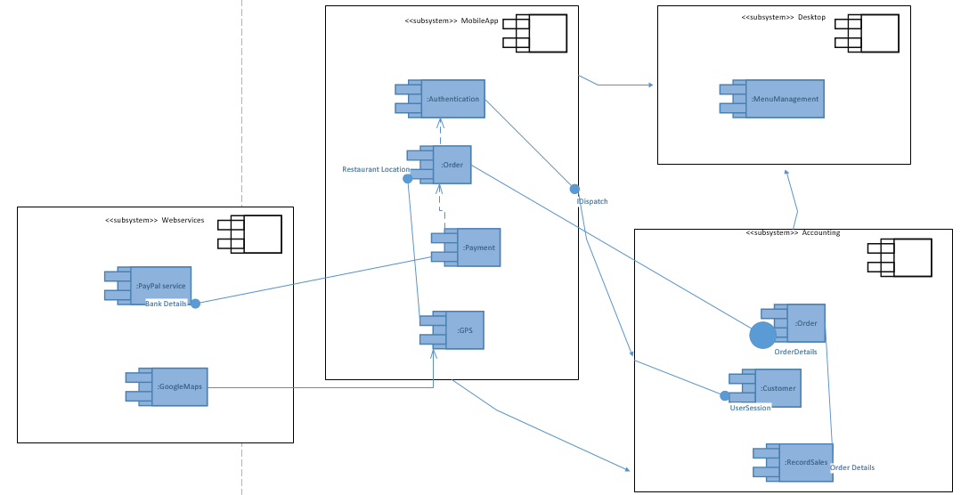
Architecture Diagram – Component Based
Notes:
The application is divided into 4 main modules : Webservices, MobileApp module , Desktop module and the accounting module
Mobile contains 4 components the AUTHENTICATION , order payment and GPS. Authentication component require data about customer’s accounts. Order component sends the order details to the component of an accounting module
PAYMENT is dependent upon ORDER
ORDER requires data about restaurant location, hence it connect with GPS, GPS component is dependent upon GOOGLEMAPS webservice of the module WEBSERVICES
RECORD SALES component of the ACOOUNTING module requires data related to ORDERS
The WEBSERVICES in this system are PAYPAL and GOOGLE MAPS

Slide 9
User Story Realization
As a user of online ordering application I want a quick approach to find all the restaurants around my location with their updated menu.
The application should be very much responsive and user friendly with restaurants delivering order on time.
Moreover, it should keep the user’s data secure so that I can freely add my personal as well as account details when using this application.

Slide 10
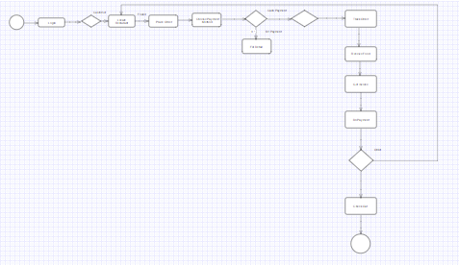
Activity Diagram
Notes:
When a user login to our app,it will decide based on the login credentials that which type of user he is. If he is customer then he will locate his required restaurant and place order. After placing order he will chose his payment method whether he will payvia credit card or by paypal. After payment, he can also track his order until the order received. Once the order received, the got the invoice of this order and he can give another order or just enjoy the order he received.

Slide 11
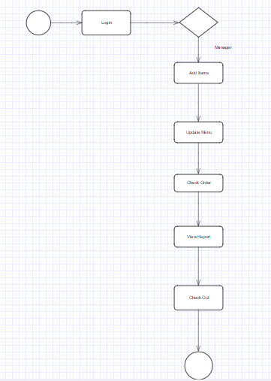
Activity Diagram
Notes:
When a user login to our app,it will decide based on the login credentials that which type of user he is. If he is manager then he can perform his managerial task like Add Items, Check Orders and View reports.

Slide 12
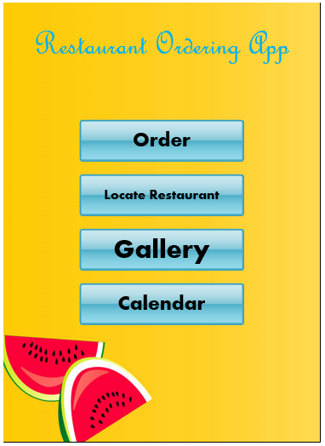
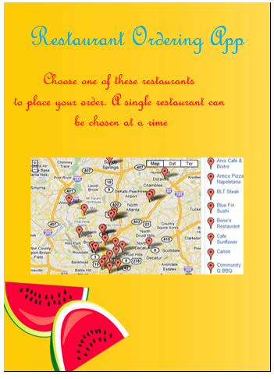
LOCATE RESTAURANT GUI
Notes:
This is our application's main GUI for customers where he can locate restaurant by using the Locate restaurant button present in menu.

Slide 13
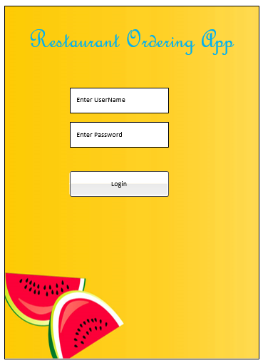
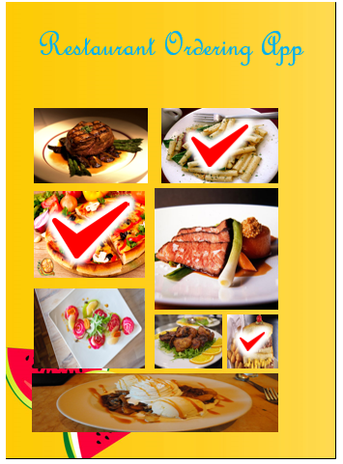
PLACE ORDER GUI
Notes:
After locating restaurant, he can place his order via main menu.

Slide 14
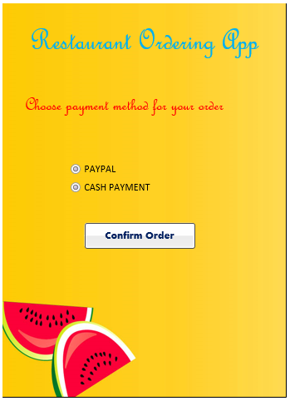
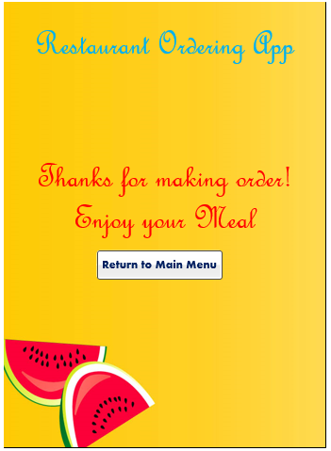
SELECT PAYMENT METHOD GUI
Notes:
Once he made the order then he can select his method of payment.

Slide 15
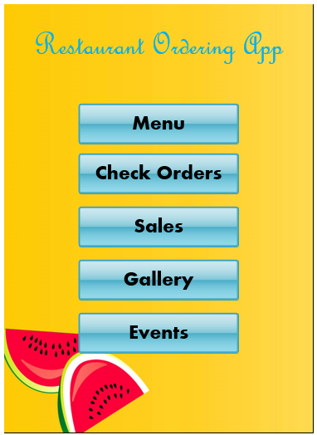
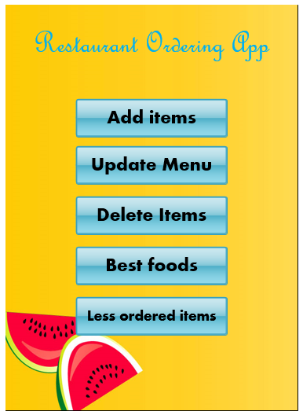
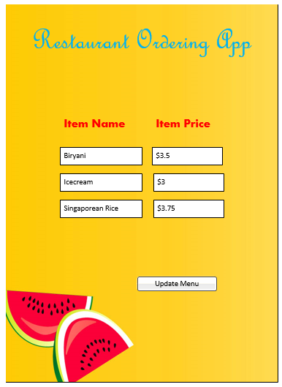
SELECT ITEM GUI
Notes:
This is manager's main GUI. Here he can add items by using sub menu.

Slide 16
UPDATE MENU GUI
Notes:
Manager can update menu by using the sub menu of his main manu. Where he can update item price and name.

Slide 17
DEMO

Slide 18
Any Questions ?

Slide 19
Thank You Have a Nice Day ☺

